Slide 1


Internship Phase-II
Hackathon
Course: Deep Learning and Reinforcement Learning
“AI Legal Assistant for Document Analysis”
Team Members :
Internship Offered By:
E2E Management Services
NAME | USN
Sanchita H | 1BG23CS131
Srusti M | 1BG23CS159

Slide 2
Project Objectives
Automate Legal Document Analysis Develop an AI-driven assistant that can upload and analyze legal PDFs to reduce manual effort and human error.
Summarize Legal Documents Intelligently Extract and generate concise, meaningful summaries using advanced NLP models trained on legal data.
Clause Detection and Visualization Identify and categorize legal clauses (e.g., Termination, Confidentiality, Arbitration) and display clause distribution visually.
Risk & Compliance Evaluation Automatically detect missing or risky clauses and compute a risk score to flag potentially fraudulent contracts.
Structured Insight Extraction Extract key information such as parties involved, agreement type, governing law, and dates to give users a high-level understanding of the contract.
End-to-End Report Generation Allow users to download summaries and compliance analysis in a clean, professional PDF format.
User-Friendly Web Interface Build an intuitive and responsive Streamlit app for both legal professionals and non-experts to interact with legal content efficiently.

Slide 3
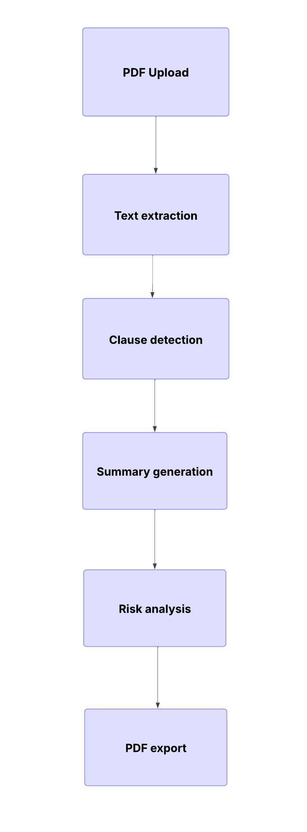
Methodology and Workflow
1. Data Sources:
CUAD dataset for clause descriptions
Fine-tuned T5 model trained on legal clause summaries
2. Preprocessing:
Extracted and cleaned text using PyMuPDF
Tokenized and normalized clause data
3. Upload & Extraction:
User uploads PDF and it is extracted as text using PyMuPDF
4. Clause Detection:
Rule-based matching for 13+ clause categories
5. Risk Assessment:
Rule engine checks clause presence & assigns risk score
6. Summarization:
Fine-tuned T5-base model generates human readable summary
7. Visualization & Output:
Clause pie chart + risk gauge +formatted PDF export
Flowchart:

Slide 4
Key Assumptions
Fine-tuned T5 model is generalizable across contract types.
Clause terminology is consistent
Input PDFs contain readable, extractable text.
Clause keyword detection is sufficient for initial clause classification.
Users are looking for quick,non-legally binding AI assistance.

Slide 5
Model Evaluation
T5-Base (Text-to-Text Transfer Transformer)
Developed by Google Research, T5 (Text-to-Text Transfer Transformer) is a transformer-based NLP model that treats every language problem as a text-to-text task.
Summarization is handled as a translation from legal text → concise summary.
Dataset Summary:
Name: tf_flowers (from TensorFlow Datasets)
Size: 3,670 images
Classes: 5 (e.g., dandelion, daisy, tulips, sunflowers, roses)
Split:
Training set: 80% (≈ 2,900 images)
Validation set: 20% (≈ 700 images)
Model Architecture
Base Variant of T5:
Encoder-Decoder transformer architecture.
220M parameters – balances accuracy and efficiency.
Works by encoding input text and then decoding the output summary.

Slide 6
Project Summary and Outcomes
Project Summary:
Built an AI-powered Legal Document Analyzer for contract review.
Used T5 transformer for clause summarization and risk detection.
Achieved accurate clause classification with rule-based extraction.
Implement compliance checker with risk scoring and visual analytics.
Validated the effectiveness of NLP and transfer learning in legal text understanding.

Slide 7
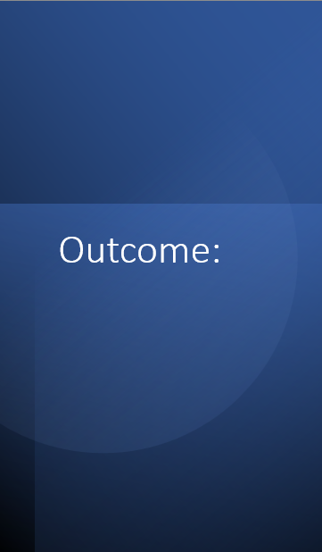
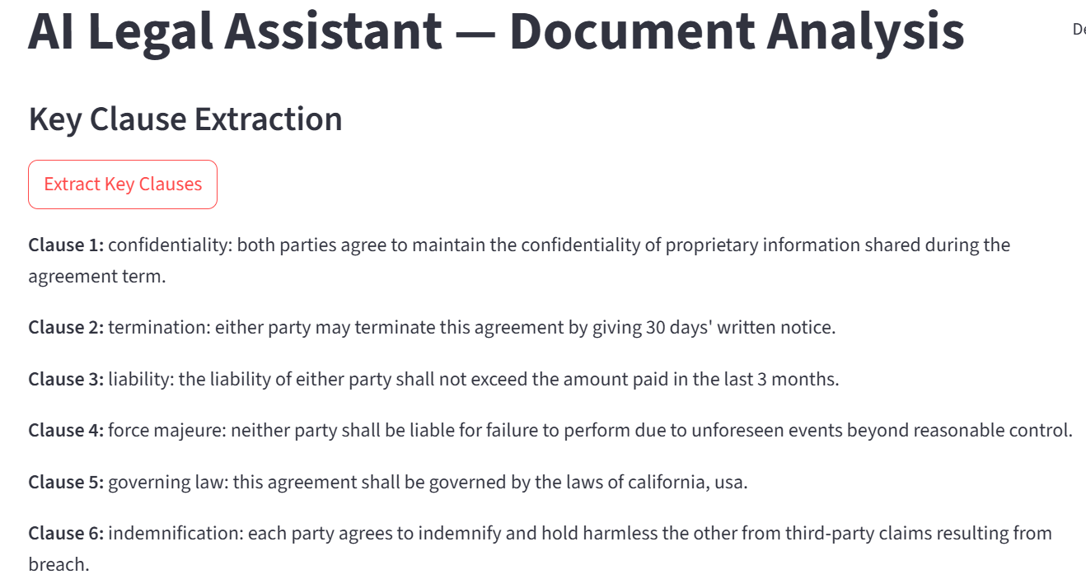
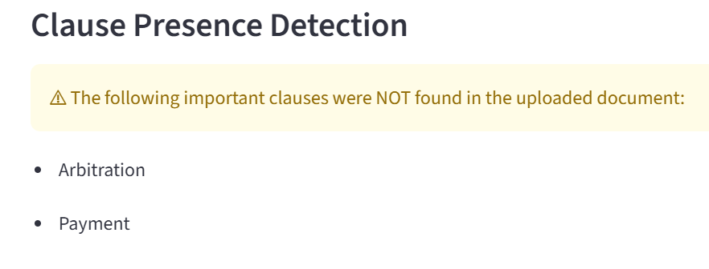
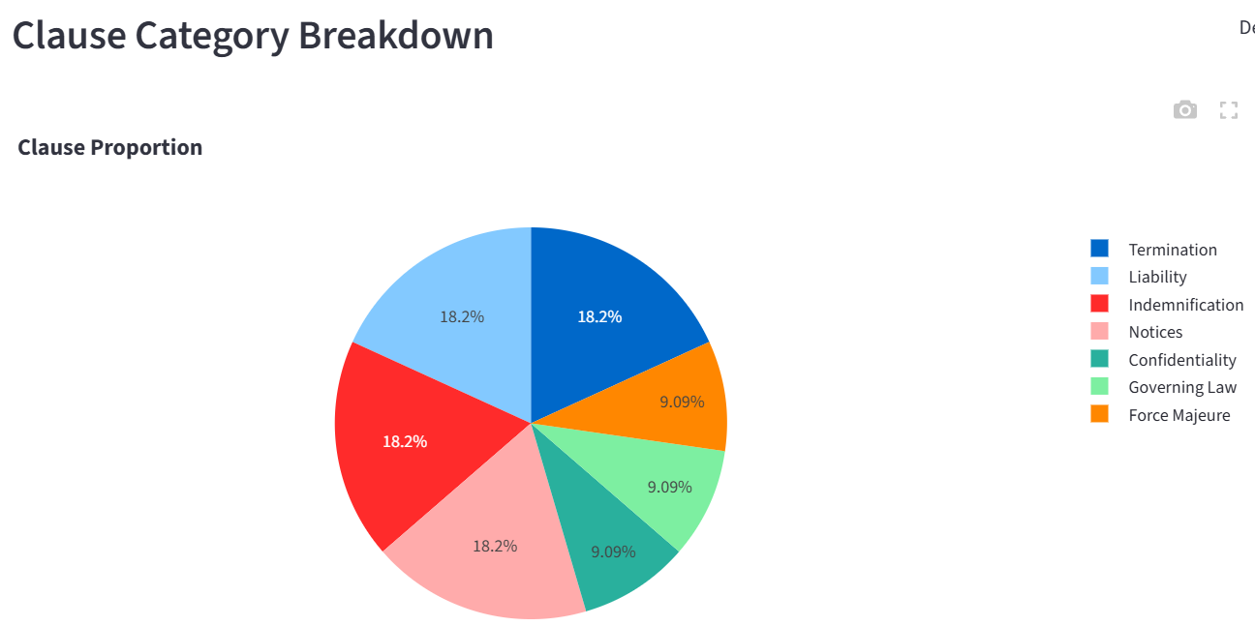
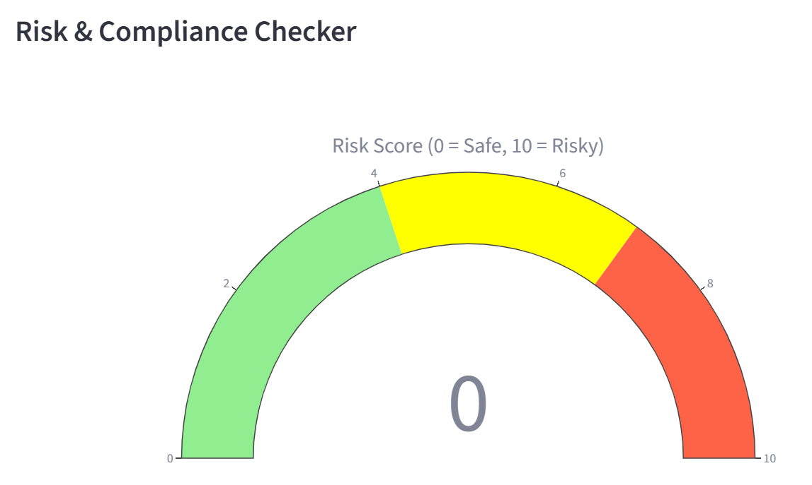
Outcome:
When a risk-free file is uploaded

Slide 8
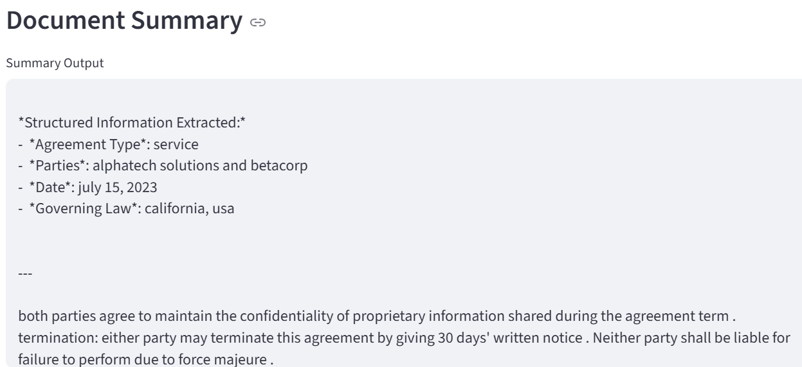
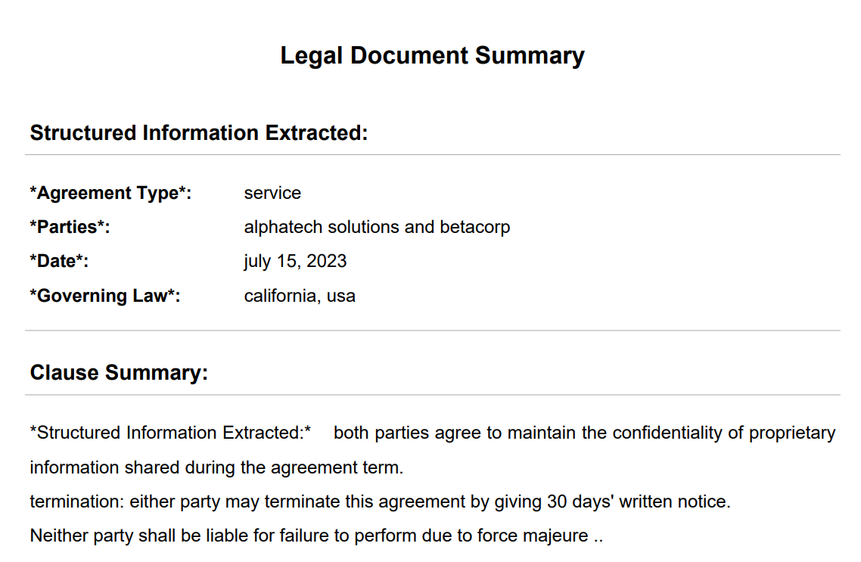
Outcome:

Slide 9
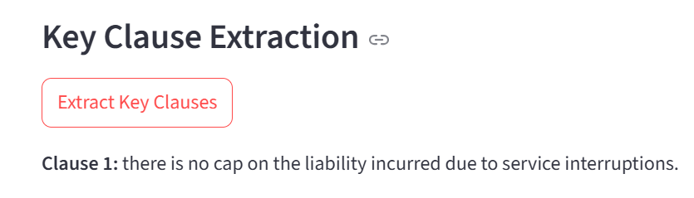
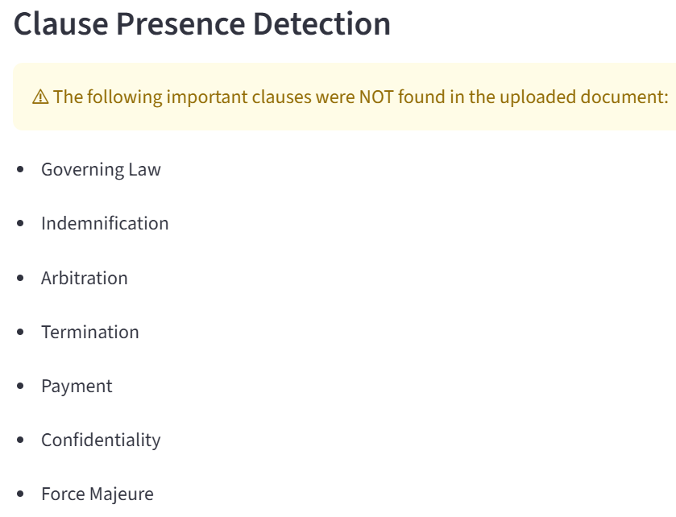
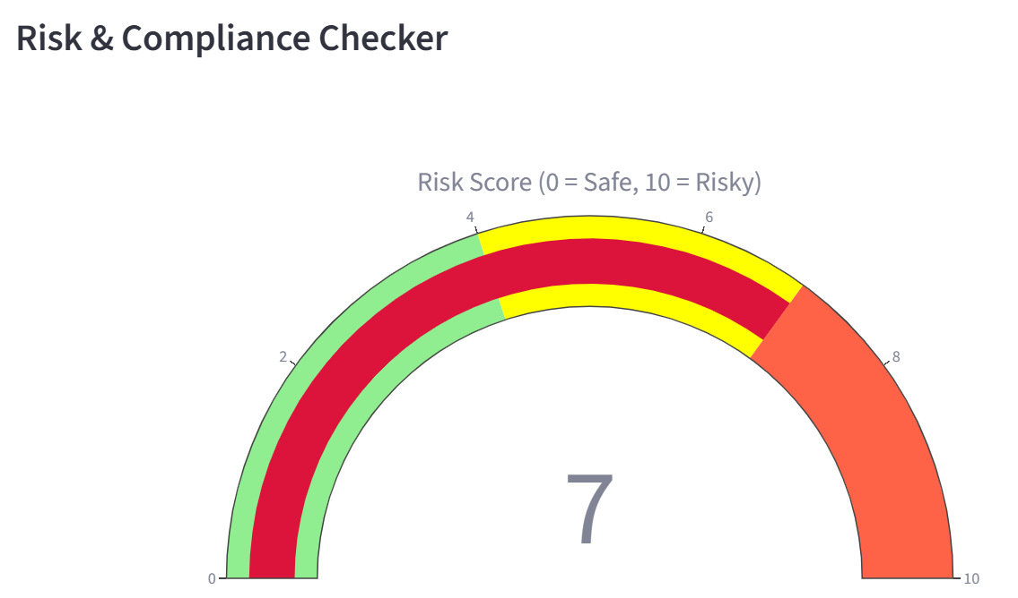
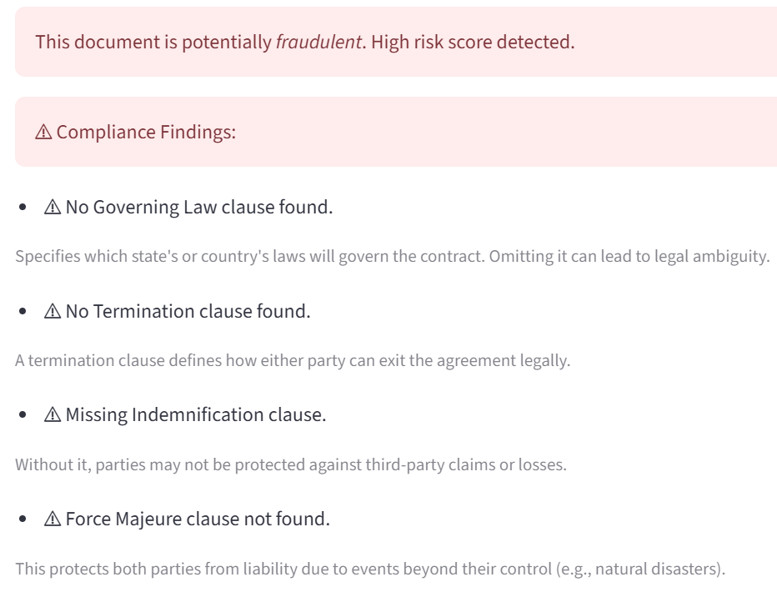
Outcome:
When a risky file is uploaded:

Slide 10
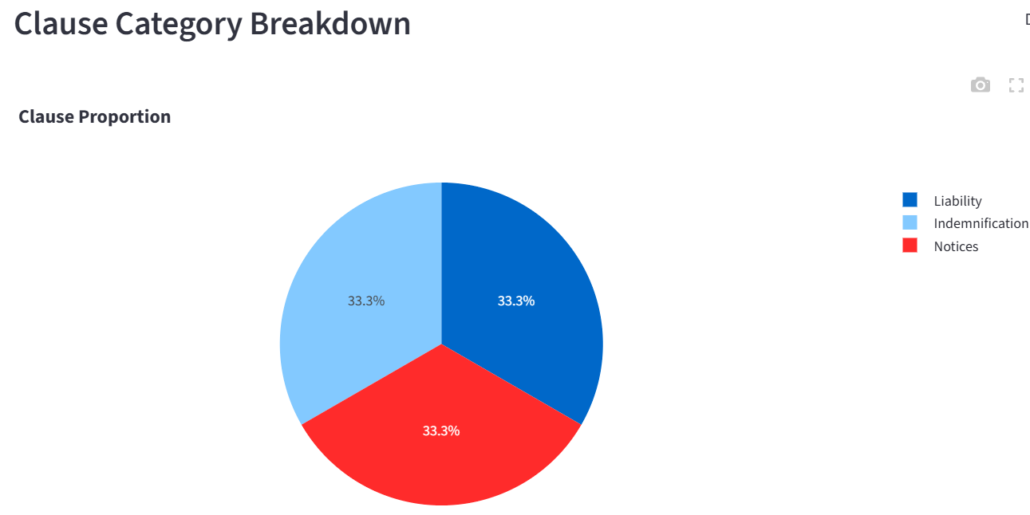
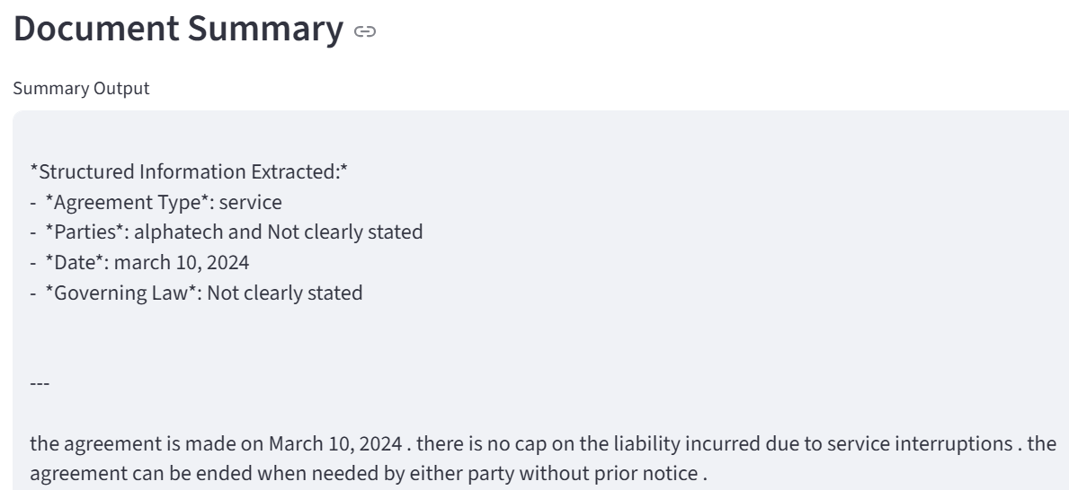
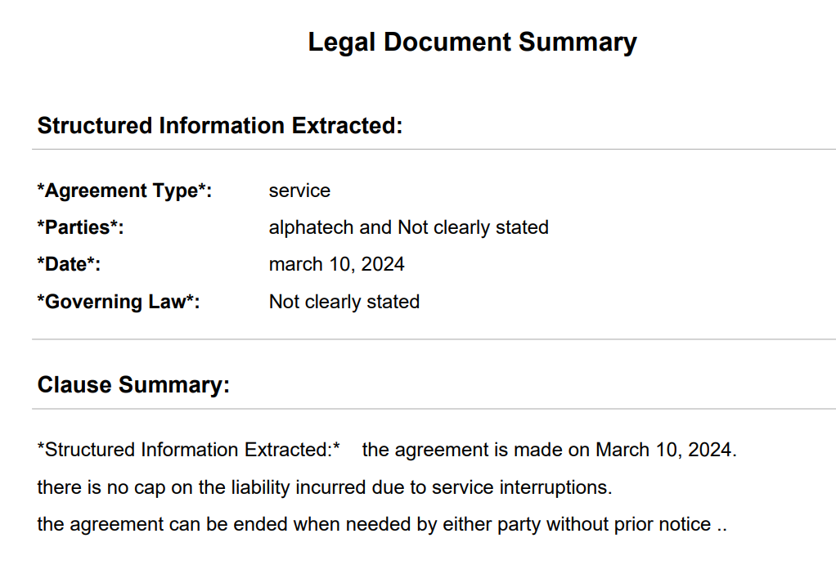
Outcome:

Slide 11
Future Improvements and Extension
Named Entity Recognition(NER): To use NLP to extract named parties, dates, obligations more accurately.
Interactive PDF Viewer: To display original PDF alongside clause highlights.
BERT-based Clause Classification: To improve clause detection with contextual understanding.
Confidential Document Security: To add encryption for uploaded files.
Feedback Loop: To let users correct clause predictions to retrain the model.

Slide 12
Reflections and Learning Outcomes
Technical Learnings
Implemented T5-base summarization using Hugging Face.
Used Streamlit to build an interactive web app.
Extracted and processed PDFs with PyMuPDF.
Conceptual Insights
Learned to chunk large legal texts for better model performance.
Understood the role of key legal clauses in compliance.
Project Reflections
Streamlit enabled fast development with a user-friendly UI.
Identified opportunities for future improvements like integrating Legal-BERT, NER, and document classification models.

Slide 13
GitHub Link :
A detailed project report, including objectives, methodology, evaluation, and learning outcomes, has also been prepared and can be accessed in the repository.
https://github.com/Srusti20/Deep-Learning-and-Reinforcement-Learning-/tree/main/AI%20Legal%20Assistant-Document%20Analysis/Project%20Files
Additional Resources: The complete source code, along with implementation details, data preprocessing pipeline, model architecture, training strategy, and evaluation scripts.
Supporting Materials:
https://github.com/Srusti20/Deep-Learning-and-Reinforcement-Learning-/tree/main/AI%20Legal%20Assistant-Document%20Analysis/PPT
https://github.com/Srusti20/Deep-Learning-and-Reinforcement-Learning-/tree/main/AI%20Legal%20Assistant-Document%20Analysis/Videos

